Slide 1

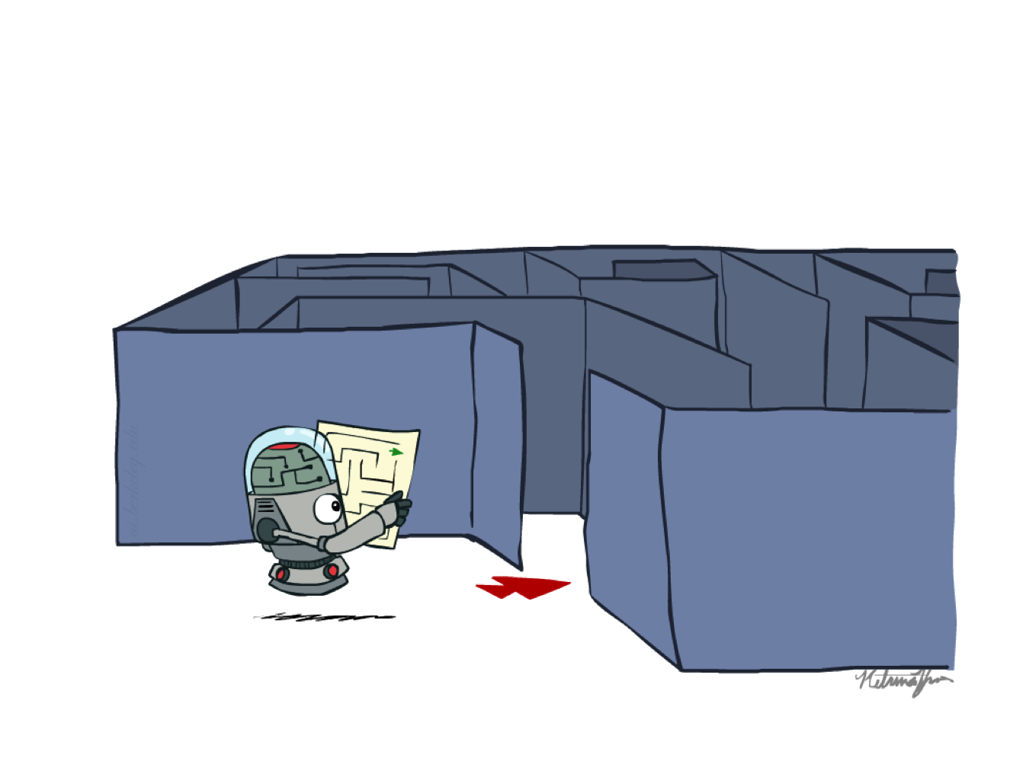
Chapter 1d
Adversarial Search
COMP 7404C
Computational Intelligence and Machine Learning
K.P. Chow & Dirk Schnieders
Most materials in this chapter are based on materials from http://aima.cs.berkeley.edu/ and http://ai.berkeley.edu
http://ai.berkeley.edu

Slide 2
Outline
Abstraction
Types of Search
Search Problem Definition
State Space Graph vs. Search Tree
Search Algorithm (TSA, GSA)
Uninformed Search
BFS, DFS, UCS
Informed Search
Greedy, A*
Local Search
Constraint Satisfaction Problems
Adversarial Search
Minimax
DLS
Horizon Effect
𝛼-𝛽 Pruning
Expectimax
Multi-Agent Utilities

Slide 3
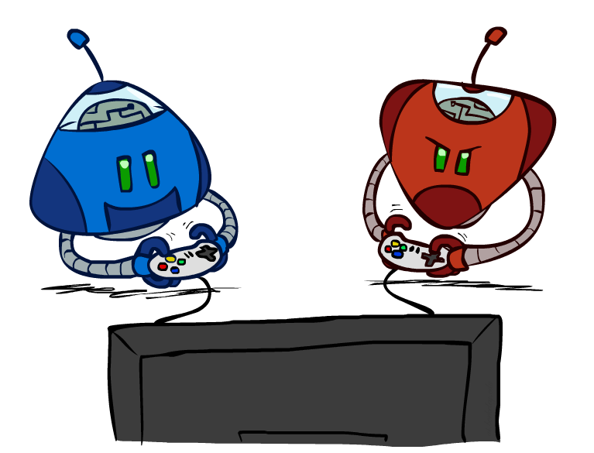
Adversarial Search
http://ai.berkeley.edu

Slide 4
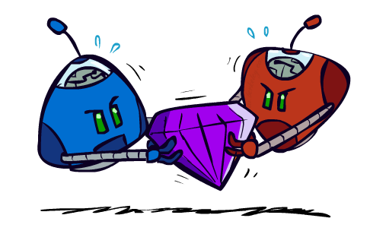
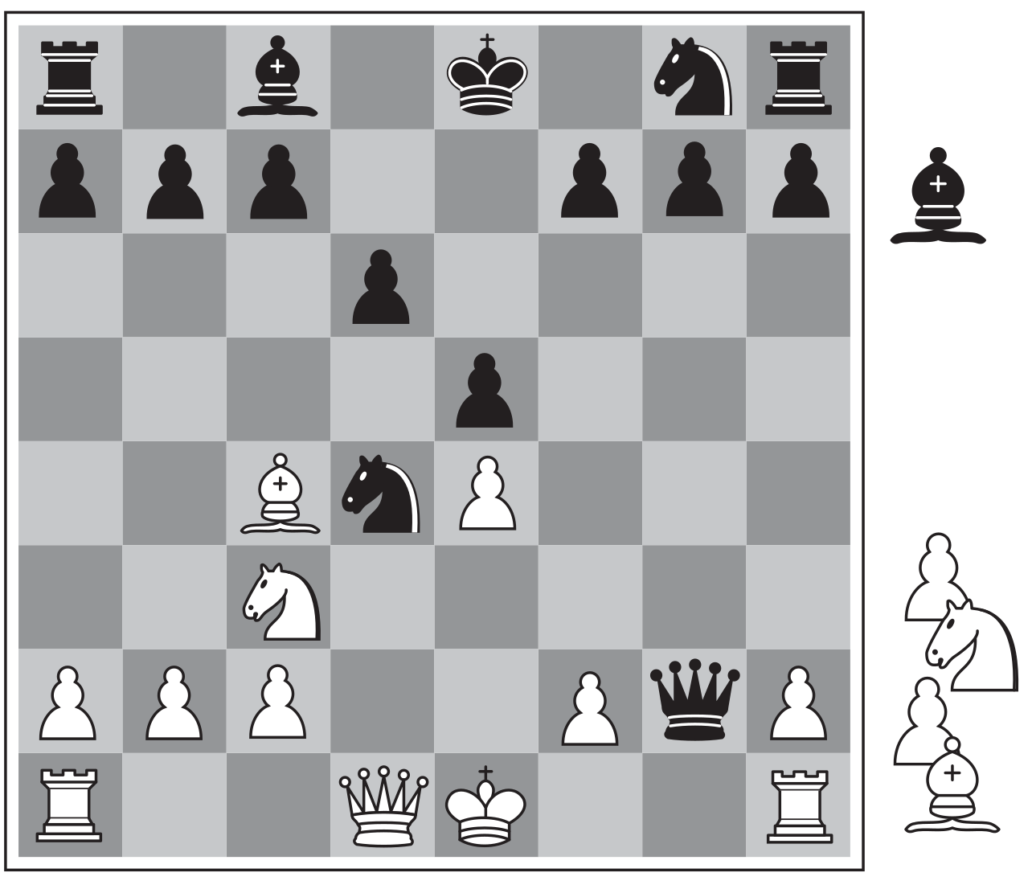
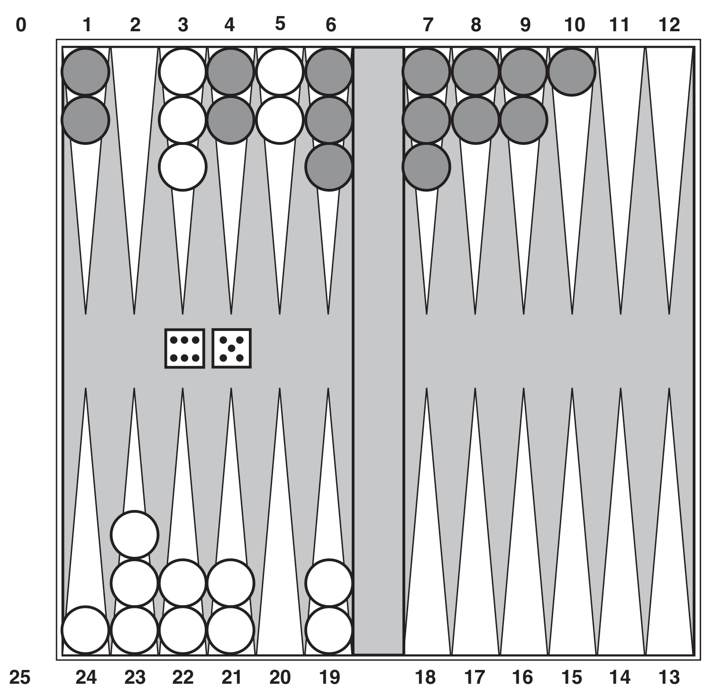
Adversarial Search
A multi-agent competitive environment
We try to plan ahead in a world where other agents are planning against us
Goals are in conflict (not necessarily)
http://ai.berkeley.edu
X | O
 | X
 | O
http://aima.cs.berkeley.edu/
http://aima.cs.berkeley.edu/

Slide 5
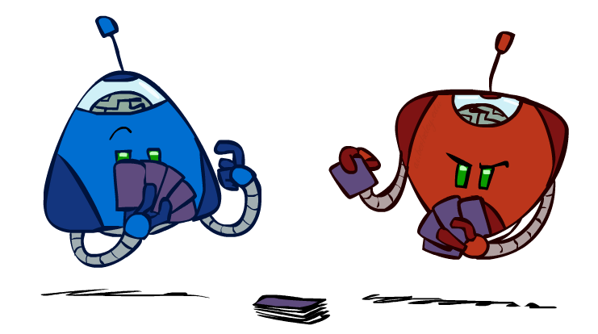
Game Definition
A game can be defined as
s : States
s₀: Initial state
Player(s) : Defines which player has the move
Actions(s) : Returns a set of legal moves
Result(s,a) : Defines the result of a move
TerminalTest(s) : True when game is over, false otherwise
Utility(s,p) : Defines the final numeric value for a game that ends in terminal state s for player p
A game tree can be constructed
Nodes are game states and edges are moves
http://ai.berkeley.edu

Slide 6
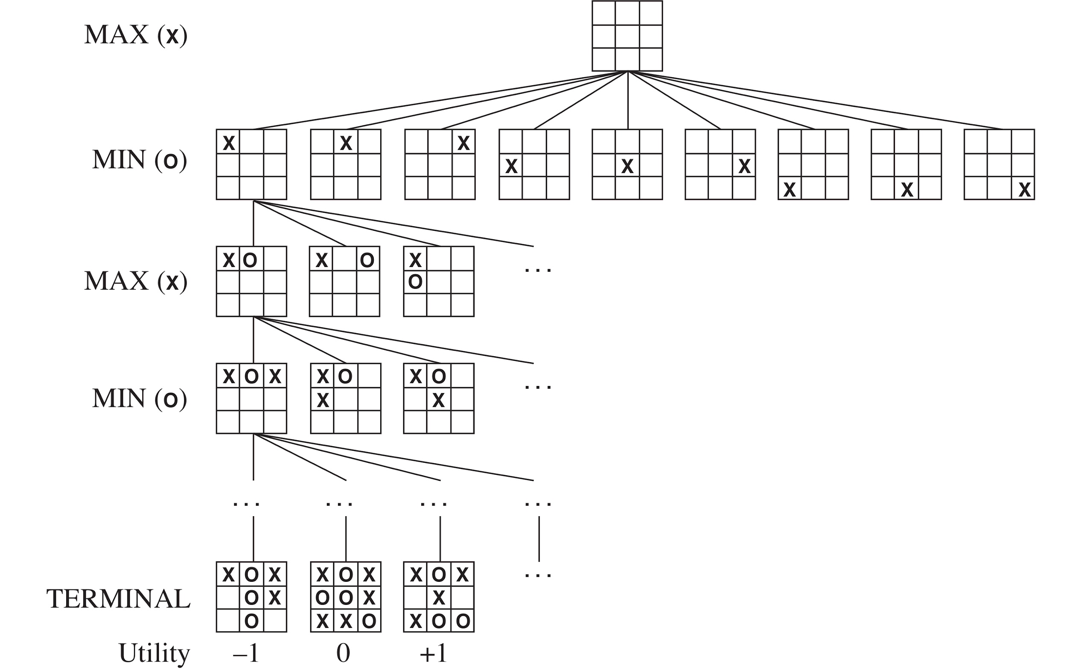
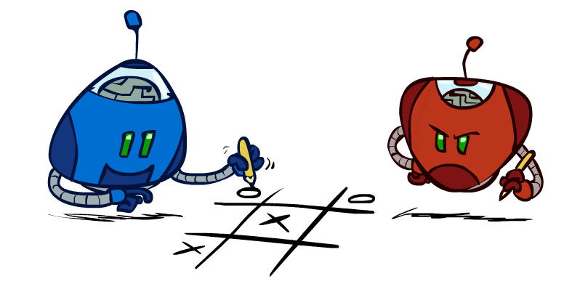
Tic-Tac-Toe Game Tree
I maximize my return
You minimize my return
http://ai.berkeley.edu

Slide 7
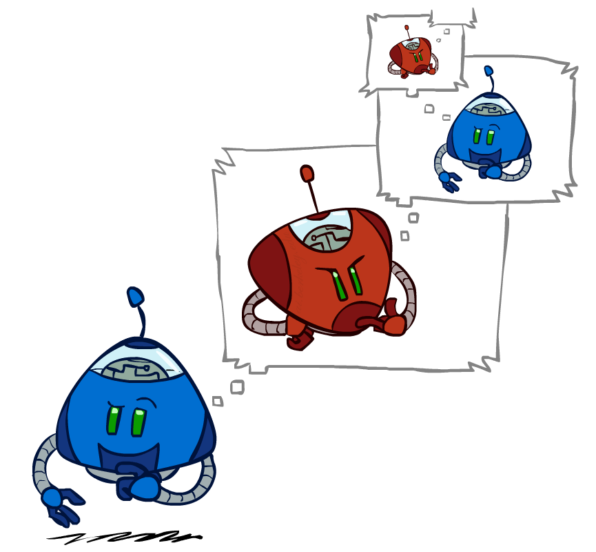
http://ai.berkeley.edu

Slide 8
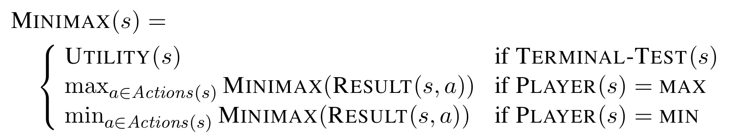
Minimax Search
A state-space search tree
Players alternate turns
Compute each node’s minimax value
the best achievable utility against a rational (optimal) adversary
Will lead to optimal strategy
Best achievable payoff against best play

Slide 9
Minimax Search - Example
MAX
3
MIN
3
2
2
TERMINAL UTILITY
3
12
8
2
4
6
14
5
2

Slide 10
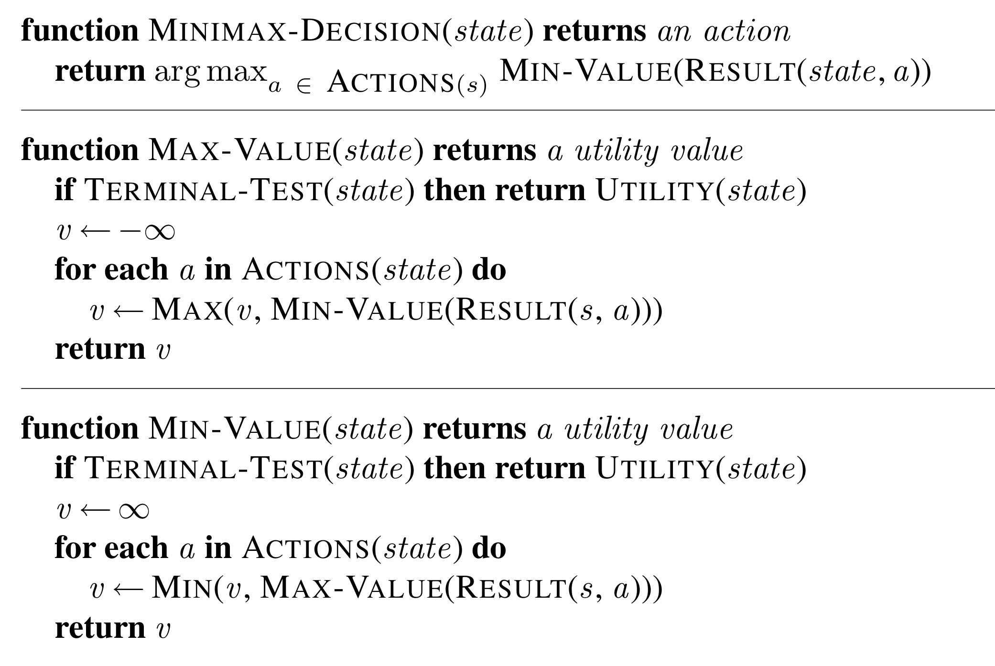
Minimax Implementation

Slide 11
Quiz
Consider the simple game tree shown below
What is the minimax value of the game tree?
Which action will the minimizer take when playing according to the minimax strategy?
MIN
MAX
MIN
TERMINAL UTILITY
3
1
8
5
1
9
0
1
3
1
8
3

Slide 12
Quiz
Consider the following game tree, where one of the leaves has an unknown payoff x
For what values of x is MAX guaranteed to choose the initial left action?
MAX
MIN
MAX
TERMINAL UTILITY
x
-8
11
-2
5
12
8
-4

Slide 13
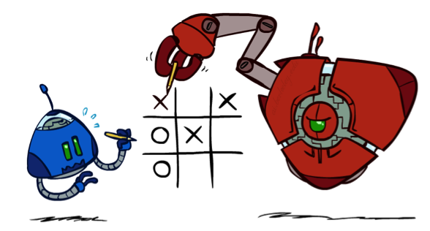
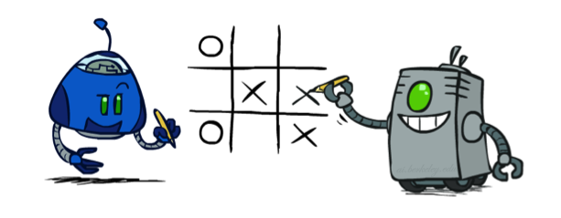
Minimax Properties
Will minimax lead to optimal play?
No
It will lead to an optimal strategy
I.e., it will be optimal against perfect play
http://ai.berkeley.edu
http://ai.berkeley.edu

Slide 14
What if Min does not play optimally?
If MIN doesn’t play optimally, will we be able to play better on average?
MAX
10
MIN
10
9
TERMINAL UTILITY
10
10
9
100

Slide 15
Minimax Properties
Complete?
Yes, if tree is finite
Optimal?
In general no, yes against an optimal opponent
Time complexity?
O(b^{m})
Space complexity
O(bm)
What do it mean by optimal component?
Minimax performs a complete DFS exploration of the tree
m: maximum length of any path in the state space

Slide 16
Example: Chess
b ≈ 35, m ≈ 100
Cannot search to leaves !
http://aima.cs.berkeley.edu/

Slide 17

Resource Limits
http://ai.berkeley.edu

Slide 18
DLS
Depth-Limit Search
DFS-TSA with a depth limit and an evaluation function
i.e., nodes at depth l have no successors and use value of evaluation function
Properties
Complete ?
No, if l < d; Yes, if l >= d
Optimal ?
No
Time ?
O(b^{l})
Space ?
O(bl)
Cut the tree here
d: depth of the shallowest solution

Slide 19
DLS
Cut the tree here and plug in these numbers from the evaluation function
Depth limited search
Search only to a limited
depth in the tree
Replace terminal utilities with an evaluation function for non-terminal positions
Problems:
Guarantee of optimal play is gone
Need to design evaluation function
-1
-2
4
9
?
?
?
?

Slide 20
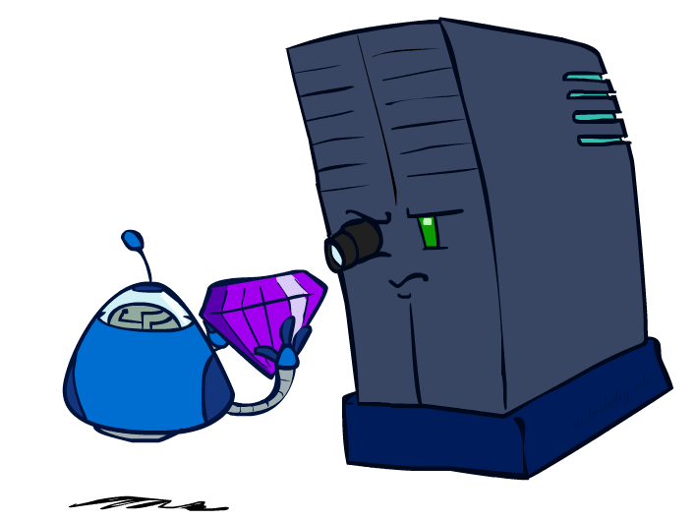
Evaluation Function
An evaluation function Eval(s) scores non-terminals in depth-limited search
An estimate of the expected utility of the game from a given position
Ideal function
The actual minimax value of the position
The performance of a game-playing program depends strongly on the quality of its evaluation function
http://ai.berkeley.edu

Slide 21
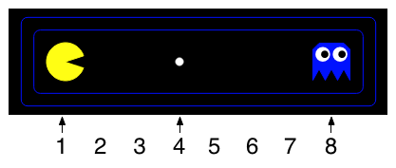
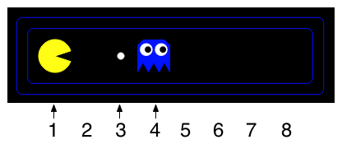
Quiz
For the two situations shown below, which evaluation functions will give the situation on the left a higher score than the situation on the right?
1 / (Pacman's distance to the nearest food pellet)
Pacman's distance to the nearest ghost
Pacman's distance to the nearest ghost + 1 / (Pacman's distance to the nearest food pellet)
Pacman's distance to the nearest ghost + 1000 / (Pacman's distance to the nearest food pellet)

Slide 22
Evaluation Function
Eval(s) = w₁f₁(s) + w₂f₂(s) + … + w_{n}f_{n}(s)
Example: Chess
Successful evaluation functions for chess compute numerical contributions from each feature
E.g., each pawn is worth 1, a knight or bishop is worth 3, a rook 5 and a queen 9
Other features such as “king safety” or “good pawn structure” might be worth half a pawn
The features and their weights are then combined
http://aima.cs.berkeley.edu/

Slide 23
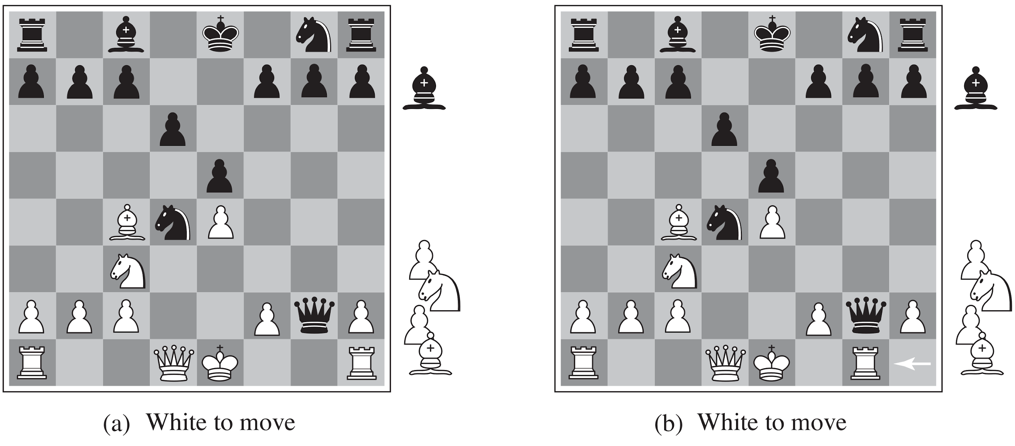
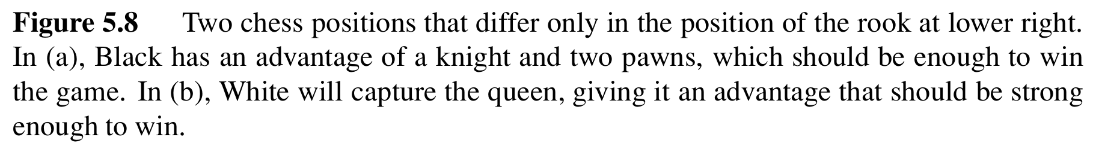
Quiz
Which player has an advantage for (a) and for (b) ?
http://aima.cs.berkeley.edu/

Slide 24
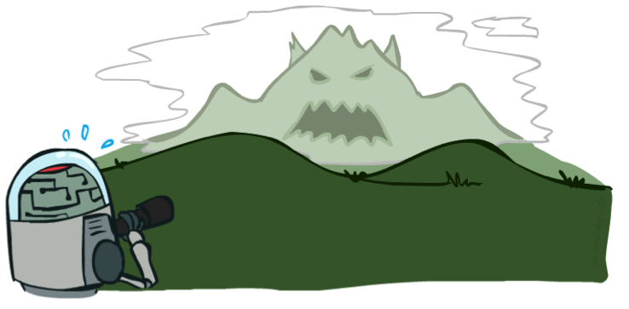

Depth Matters
Evaluation functions are always imperfect
The deeper in the tree the evaluation function is buried, the less the quality of the evaluation function matters
An important example of the trade off between complexity of features and complexity of computation
http://ai.berkeley.edu
http://ai.berkeley.edu

Slide 25
Horizon Effect
Consider an opponent’s move that causes serious damage and is ultimately unavoidable
With a low depth limit we don’t know that the damage is ultimately unavoidable
Employing delaying tactics to temporality avoided the damage may cause even more damage
http://ai.berkeley.edu

Slide 26
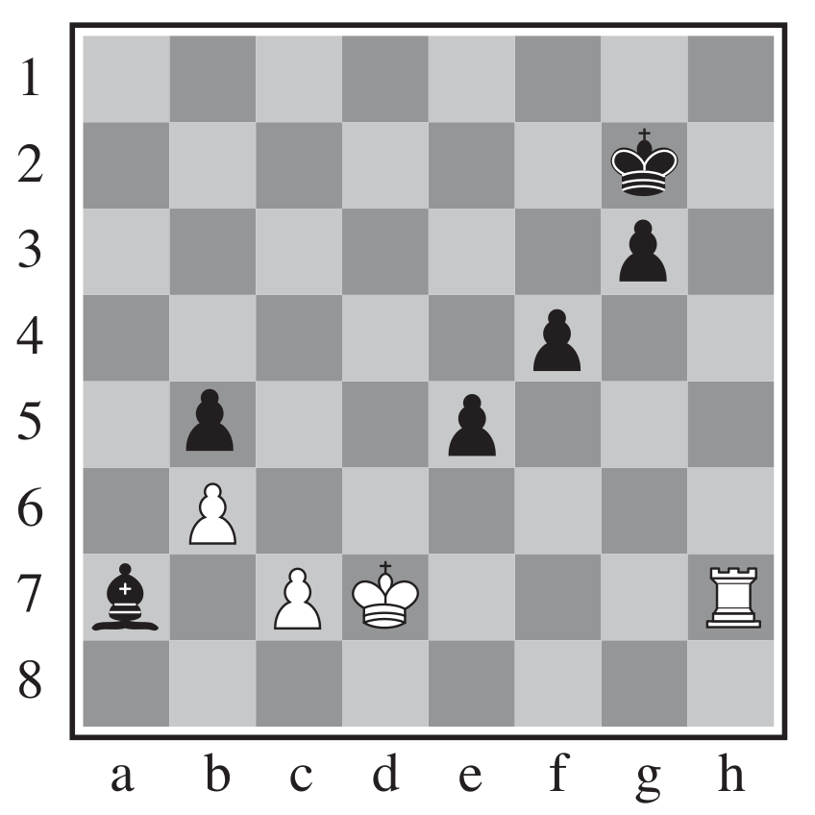
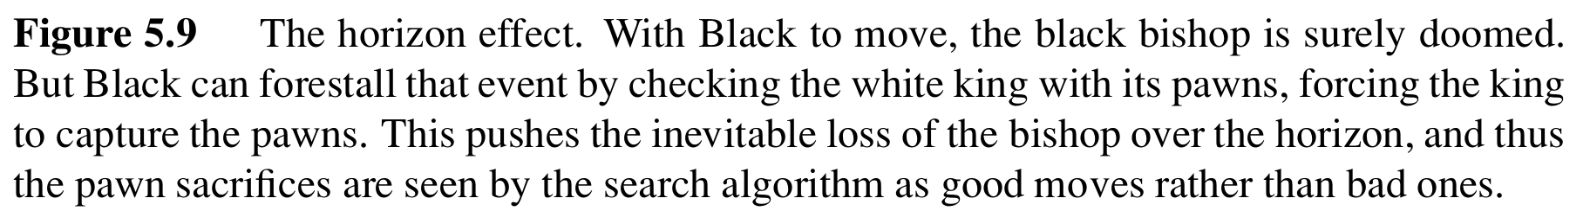
Horizon Effect - Example
Horizon effect (in many games): the number of possible states is immense and computers can only feasibly search a small portion of them, e.g., for a computer searching only five plies, there is a possibility that it will make a detrimental move, but the effect is not visible because the computer does not search to the depth of the error (i.e., beyond its "horizon").
Consider the following example
Can black save its bishop?
Black to move
http://aima.cs.berkeley.edu/
http://aima.cs.berkeley.edu/
Notes:
There is no way for the black bishop (a7) to escape, because move to b6 to be killed by pawn at c7, move to b8 then c7 to be killed by king at d7.
If black pawn at e5 move to e6, forcing king at d7 move to e6, then black bishop can escape.

Slide 27
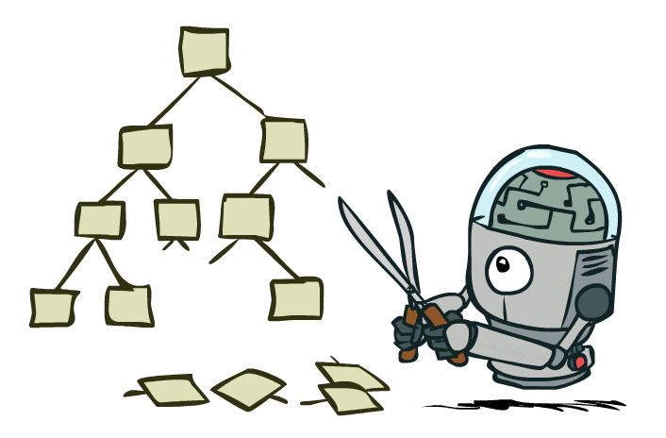
Game Tree Pruning
Is it possible to compute the correct minimax value without looking at every node?
http://ai.berkeley.edu

Slide 28
Pruning - Motivation
http://ai.berkeley.edu
MAX
>=3
MIN
m
<=3
3
n
<=2
No need to check other children! The maximizer above this node is not going to choose it ...
TERMINAL UTILITY
3
12
8
2

Slide 29
Pruning
The 𝛼-𝛽 pruning algorithm can determine the minimax value without looking at all the nodes
http://ai.berkeley.edu

Slide 30
𝛼-𝛽 Pruning Algorithm
Min version
Consider Min’s value at some node n
n will decrease (or stay constant) while the descendants of n are examined
Let m be the best value that Max can get at any choice point along the current path from the root
If n becomes worse (<) than m
Max will avoid it
Stop considering n’s other children
Max version is symmetric
m
n

Slide 31
Alpha-Beta Pruning - MaxPlayer
function alphabeta(node, depth, α, β, maximizingPlayer) is
if depth = 0 or node is a terminal node then
return the heuristic value of node
if maximizingPlayer then
value := −∞
for each child of node do
value := max(value, alphabeta(child, depth − 1, α, β, FALSE))
α := max(α, value)
if α ≥ β then
break (* β cut-off *)
return value
else (* MinPlayer *)
At MaxPlayer, you upate
𝛼 = best explored option along path to root for max
𝛽 = best explored option along path to root for min

Slide 32
Alpha-Beta Pruning - MinPlayer
function alphabeta(node, depth, α, β, maximizingPlayer) is
(* if MaxPlayer *)
else
value := +∞
for each child of node do
value := min(value, alphabeta(child, depth − 1, α, β, TRUE))
β := min(β, value)
if α ≥ β then
break (* α cut-off *)
return value
alphabeta(origin, depth, −∞, +∞, TRUE) (* Initial call *)
At MinPlayer, you upate
𝛼 = best explored option along path to root for max
𝛽 = best explored option along path to root for min

Slide 33
𝛼-𝛽 Pruning Example
𝛼 = best explored option along path to root for max
𝛽 = best explored option along path to root for min
Pruning Conditions: 𝛼 >= 𝛽 (max)
(−∞, +∞)
(−∞, +∞)
(−∞, +∞)
𝛼 >= 𝛽 ?
(4, +∞)
No, continue
ret 4
4

Slide 34
𝛼-𝛽 Pruning Example
𝛼 = best explored option along path to root for max
𝛽 = best explored option along path to root for min
Pruning Conditions: 𝛼 >= 𝛽 (max)
(−∞, 6)
ret 6
(4, +∞)
(6, +∞)
ret 6
4
6

Slide 35
𝛼-𝛽 Pruning Example
𝛼 = best explored option along path to root for max
𝛽 = best explored option along path to root for min
Pruning Conditions: 𝛼 >= 𝛽 (max)
(−∞, 6)
𝛼 >= 𝛽 ?
(7, 6)
7 > 6 ?
YES
ret 7
4
6
7

Slide 36
𝛼-𝛽 Pruning Example
𝛼 = best explored option along path to root for max
𝛽 = best explored option along path to root for min
Pruning Conditions: 𝛼 >= 𝛽 (max)
β cut-off
4
6
7

Slide 37
𝛼-𝛽 Pruning Example
𝛼 = best explored option along path to root for max
𝛽 = best explored option along path to root for min
Pruning Conditions: 𝛼 >= 𝛽 (max)
(6, +∞)
ret 6
(−∞, 6)
(6, +∞)
(6, +∞)
𝛼 >= 𝛽 ?
ret 1
4
6
7
1

Slide 38
𝛼-𝛽 Pruning Example
𝛼 = best explored option along path to root for max
𝛽 = best explored option along path to root for min
Pruning Conditions: 𝛼 >= 𝛽 (max)
(6, +∞)
(6, 2)
ret 2
ret 2
4
6
7
1
2

Slide 39
𝛼-𝛽 Pruning Example
𝛼 = best explored option along path to root for max
𝛽 = best explored option along path to root for min
Pruning Conditions: 𝛼 >= 𝛽 (max)
𝛽 <= 𝛼 ?
(6, 2)
YES
4
6
7
1
2

Slide 40
𝛼-𝛽 Pruning Example
𝛼 = best explored option along path to root for max
𝛽 = best explored option along path to root for min
Pruning Conditions: 𝛼 >= 𝛽 (max)
α cut-off
4
6
7
1
2

Slide 41
𝛼-𝛽 Pruning Example
𝛼 = best explored option along path to root for max
𝛽 = best explored option along path to root for min
Pruning Conditions: 𝛼 >= 𝛽 (max)
(6, +∞)
(6, +∞)
(6, 8)
𝛽 <= 𝛼 ?
ret 8
(6, +∞)
(8, +∞)
ret 8
ret 1
4
6
7
1
2
8
1

Slide 42
𝛼-𝛽 Pruning Example
𝛼 = best explored option along path to root for max
𝛽 = best explored option along path to root for min
Pruning Conditions: 𝛼 >= 𝛽 (max)
(6, 8)
𝛼 >= 𝛽 ?
(6, 8)
(9, 8)
ret 9
4
6
7
1
2
8
1
9

Slide 43
𝛼-𝛽 Pruning Example
𝛼 = best explored option along path to root for max
𝛽 = best explored option along path to root for min
Pruning Conditions: 𝛼 >= 𝛽 (max)
4
6
7
1
2
8
1
9
β cut-off

Slide 44
Quiz
For the game tree shown below, which branches will be pruned by alpha-beta pruning?
10
8
4
50

Slide 45
Quiz
For the game tree shown below, which branches will be pruned by alpha-beta pruning?
10
6
99
8
1
2
20
4

Slide 46
𝛼-𝛽 Pruning Properties
Pruning has no effect on the minimax value at the root
However, values of intermediate nodes might be wrong
Action selection not appropriate for this simple version of alpha-beta pruning
We are unsure which action will let to the minimax value at the root
10
10
<=10
10
10
0

Slide 47
Move Ordering
The effectiveness of alpha-beta pruning is highly dependent on the order in which states are examined
What if we change the order of this node’s descendants ?
3
12
8
2
4
6

Slide 48
Alpha-Beta Pruning Properties
It is worthwhile to try to examine first the successors that are likely best
If this can be done, then it turns out that alpha-beta needs to examine only O(b^{m/2}) nodes to pick the best move, instead of O(b^{m}) for minimax
Knuth, D. E., and Moore, R. W. An analysis of Alpha-Beta pruning, 1975

Slide 49
Worst Case vs. Average Case
MAX
10
MIN
10
9
TERMINAL UTILITY
10
10
9
100

Slide 50
Worst Case vs. Average Case
MAX
54.5
CHANCE
10
54.5
TERMINAL UTILITY
10
10
9
100

Slide 51
Chance Note
Why wouldn’t we know what the result of an action will be?
Explicit randomness: rolling dice
Unpredictable opponents: the ghosts respond randomly
Actions can fail: when moving a robot, wheels might slip

Slide 52
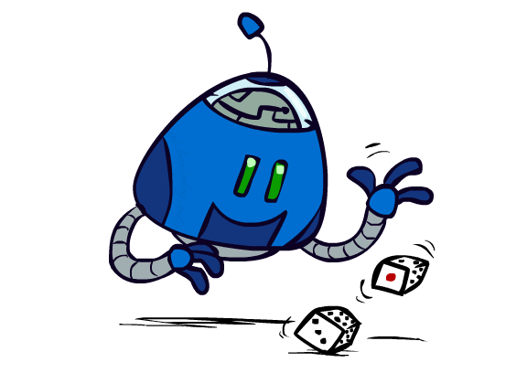
Expectimax Search
Values reflect average case outcomes, not worst case outcomes
Expectimax search computes the expected score under optimal play
Max nodes as in minimax search
Chance nodes are like min nodes but the outcome is uncertain
Calculate their expected utilities
I.e., take weighted average of children
http://ai.berkeley.edu

Slide 53
Expectimax Search Example
MAX
2.1
CHANCE
2.1
1.3
0.9
0.1
0.9
0.1
TERMINAL UTILITY
2
3
1
4

Slide 54
Quiz
Given the maze below, build the expectimax tree. Assume that Pacman moves first, followed by the lower left ghost, then the top right ghost
Rules:
Ghosts cannot change direction unless they are facing a wall.The possible actions are east, west, south, and north (not stop). Initially, they have no direction and can move to any adjacent square
We use random ghosts which choose uniformly between legal moves
Assume that Pacman cannot stop
The game is scored as follows
-1 for each action Pacman takes
10 for each food dot eaten
-500 for losing (if Pacman is eaten)
500 for winning (all food dots eaten)

Slide 55
Expectiminimax Search
Expectiminimax
Environment is an extra “random agent” player that moves after each min/max agent
2.1
2.1
1.3
.9
.1
.9
.1
2
3
1
4
http://aima.cs.berkeley.edu/
2
3
3
4
1
2
4
6

Slide 56

Multi-Agent Utilities
http://ai.berkeley.edu

Slide 57
Multi-Agent Utilities
Generalisation of minimax
Terminals and nodes have utility vectors
Each player maximizes its own component
Gives rise to cooperation and competition dynamically
5;2;5
1;6;6
5;2;5
1;6;6
6;1;2
5;1;7
5;2;5
1;6;6
7;1;2
6;1;2
7;2;1
5;1;7
1;5;2
7;7;1
5;2;5

